Slide 1
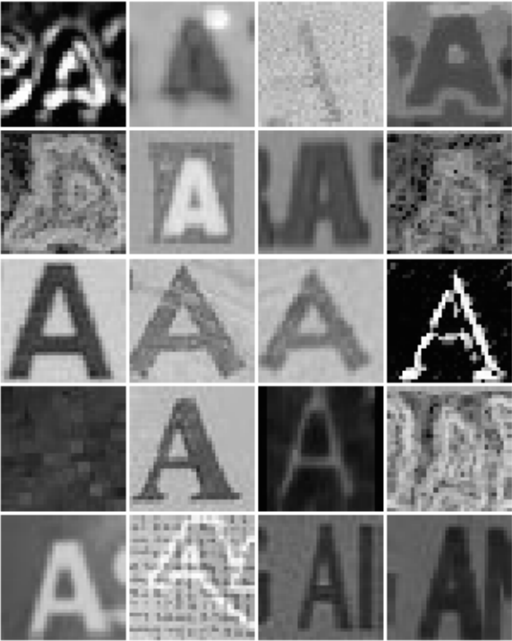
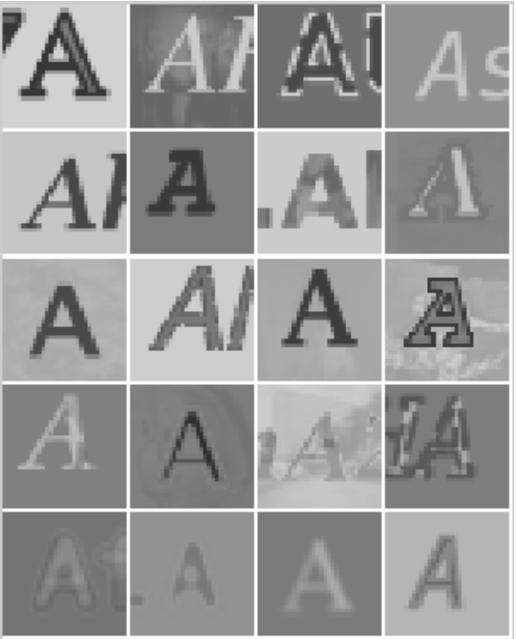
pCA for Object character recognition
eLHAM alzaki
NashAwna Olton
Beverly abadines

Slide 2
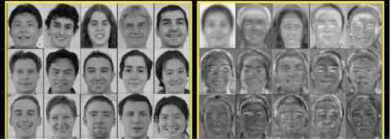
introduction
Purpose:
1) Apply PCA for OCR
2) Convert images

Slide 3
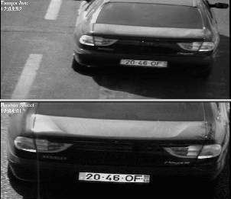
Introduction (cont)
Significance:
Allow files to be saved/modified
1) Licenses plate
2) Recognition
3) Files (scan)

Slide 4
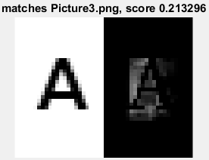
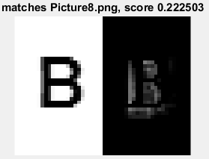
Introduction (cont)
Goal: to recognize and convert images of letters into texts
Test effects of data compression

Slide 5
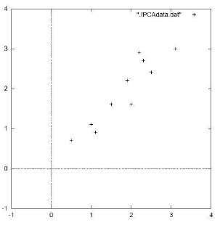
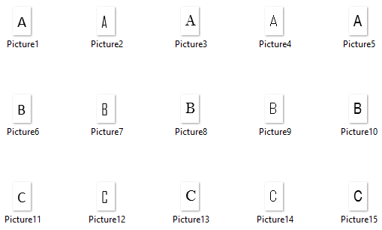
Methodology framework:
Develop the Data
Centralize the Data
Find Eigenvalue and Eigenvectors
Test Images and Output Results
Develop Bigger Data

Slide 6

Results and discussions:
Dataset One: (912 x 15)
Test Images: ‘ABC’
Fonts: Calibri, AgencyFb, BellMT, MS Gothic, Arial Narrow
Output:
3 out of 3 Letters Correct!

Slide 7
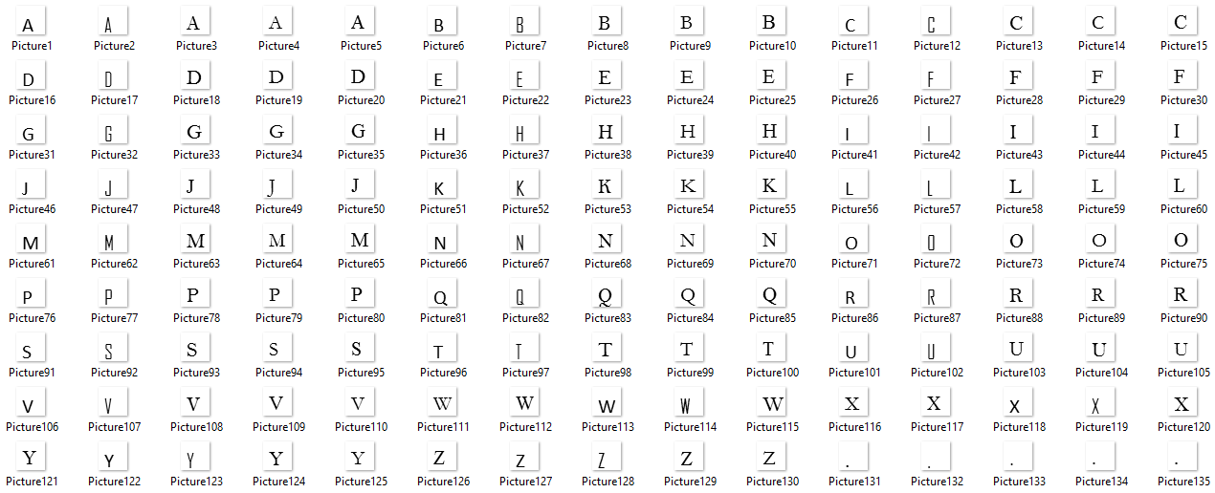

Results and discussions:
Dataset Two: (900 x 135)
Test Images: ‘THE QUICK BROWN FOX JUMPS OVER LAZY DOG’
Fonts: Calibri, AgencyFb, BellMT, Garamond, and Times New Roman
Output:
29 out of 39 Letters & Spaces

Slide 8
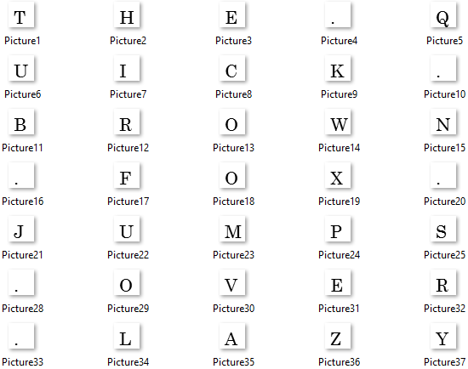

Results and discussions:
Dataset Three: (2025 x 135)
Test Images: ‘THE QUICK BROWN FOX JUMPS OVER LAZY DOG’
Fonts: Calibri, AgencyFb, BellMT, Garamond, and Times New Roman
Output:
Inconclusive
Notes:
Although PCA provides lower dimensionality representation of more complicated multivariable information, it does experience loss of information, which can have minor or major effects depending on the type and size of the data.

Slide 9

Problems & Improvements
Problems:
1) Image Dimensions- (not matching)
2) Images were not Grayscale
3) Background color of image caused interference
4) Image type (not all same)
5) Calculations (eigenvalues and eigenvectors)
6) Test image (was not recognized)

Slide 10
Solution
1) Matched Dimensions (24x38)
2) Grayscale implementation (rgb2gray)
3) Background function (imread() )
4) Changed image type ( int to double)
5) Changed Functions ( princomp() to pca() )
6) Directory ( changed directories to run test image)

Slide 11
Benefits
Knowledge:
1) Learned Statistical procedure of
PCA and SVD.
2) Learned Covariance matrix implementation in
Mat lab
3) Dimensionality reduction by mapping
4) Expanded knowledge on linear transformations
5) Train images by reshaping and mapping

Slide 12
benefits (cont)
Skills and techniques:
1) Mat lab Coding
2) Troubleshooting
3) Research

Slide 13
tHE end

